Slide 1
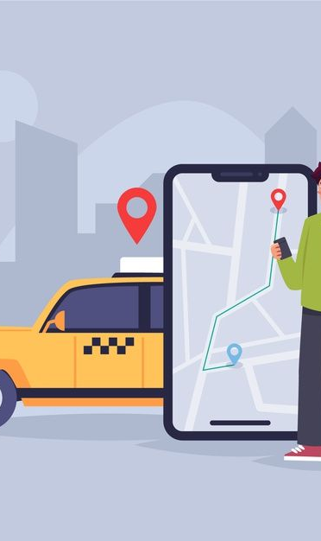
Uber Project Analysis
Presented By:-Ankit Rajak
Project File:-Uber Project Analysis

Slide 2
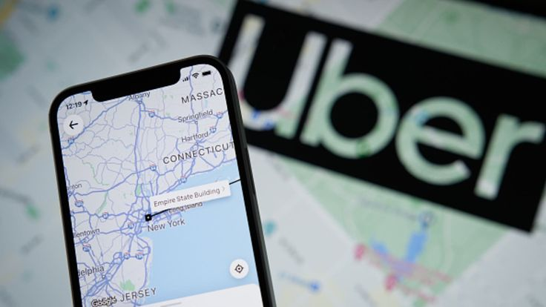
Introduction:-
Uber is a global ride-hailing service that revolutionized the way people commute by connecting passengers with drivers through a mobile app. Founded in 2009, Uber provides an efficient, convenient, and cost-effective solution for urban transportation, allowing users to book rides, track their journey in real-time, and make cashless payments. Operating in hundreds of cities worldwide, Uber offers various ride options tailored to customer needs, such as UberX for affordability, Uber BLACK for premium services, and Uber POOL for shared rides.
In addition to ride-hailing, Uber has expanded its services to include food delivery (Uber Eats), freight transportation (Uber Freight), and other mobility solutions. By leveraging technology and data analytics, Uber enhances user experiences, optimizes routes, and ensures safety through features like driver ratings and background checks. Uber has reshaped modern transportation, making it more accessible and transforming urban mobility globally. Its focus on innovation continues to drive the future of transportation.

Slide 3
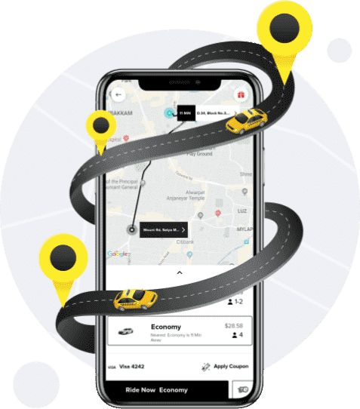
Objective:-
Summarise The Data Set:-
The objective of Uber analysis is to examine key operational and business metrics to gain insights into ride-sharing trends, customer behavior, and performance efficiency. By analyzing data on ride demand, driver availability, trip duration, pricing, and customer satisfaction, this analysis aims to identify patterns that influence profitability and service quality. Additionally, it seeks to uncover factors impacting surge pricing, geographic ride distribution, and customer retention. This comprehensive analysis provides actionable insights to optimize fleet management, reduce wait times, improve customer experiences, and enhance operational efficiency, ultimately helping Uber make data-driven decisions to drive growth and competitiveness in the ride-sharing industry.

Slide 4
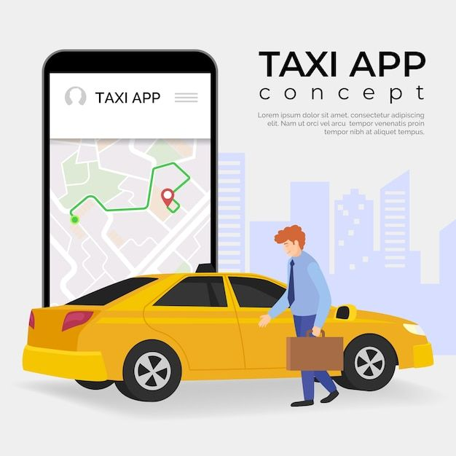
Key Questions:-
1.In Which category do people book the most uber rides?
2.For which purpose do people book uber the most?
3.At what time do people book cabs the most from uber?
4.In which months do people book uber rides less frequently?
5.On which days of the week do people book uber rides the most?
6.How many miles do people usually book a cab for through uber?

Slide 5
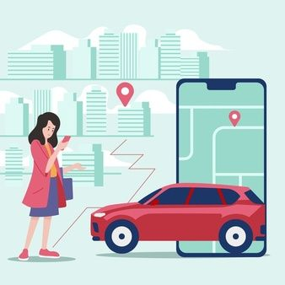
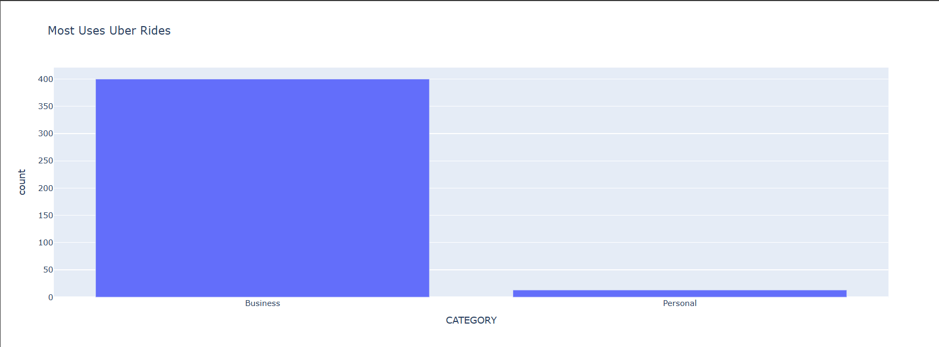
1.In Which category do people book the most uber rides?
Observation:- For Uber business and personal bookings, Uber Business Comfort and Uber Premier are the most booked classes. These classes offer comfortable rides, priority pickup, and professional drivers, making them suitable for both business and personal travelers seeking a hassle-free experience.

Slide 6
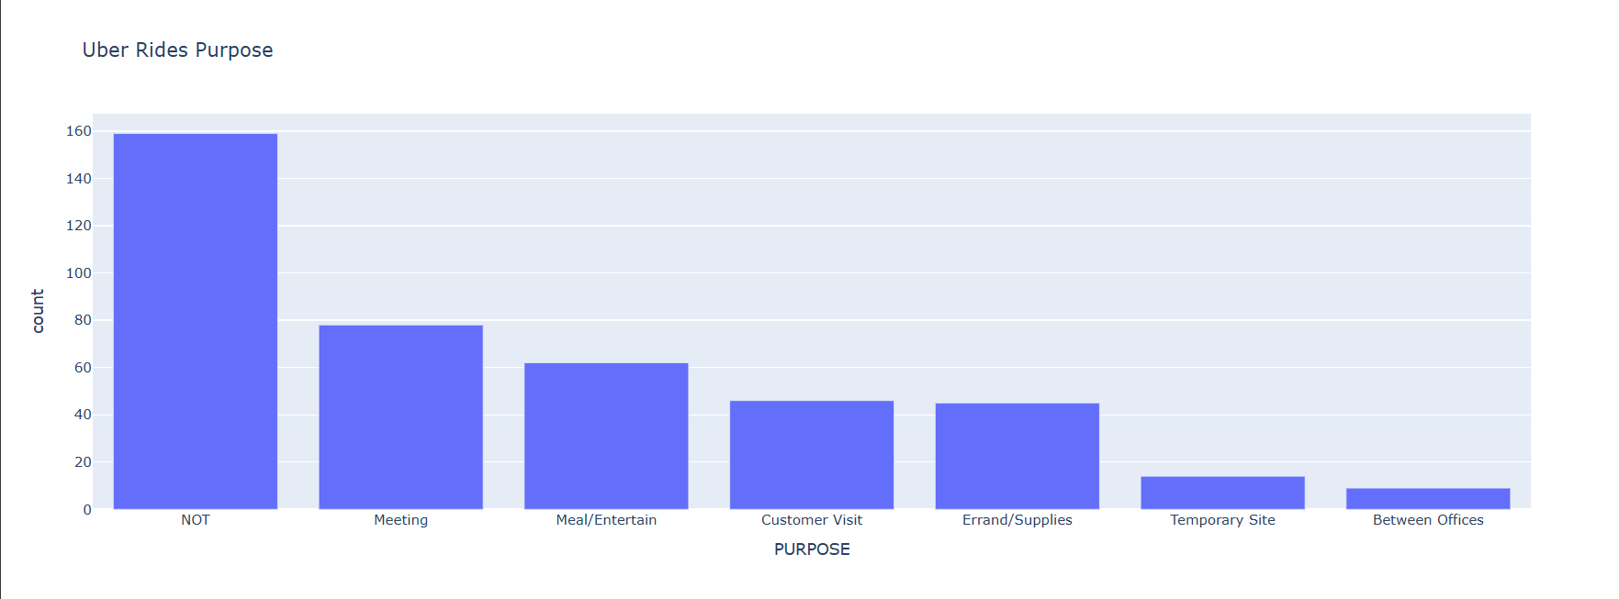
2.For which purpose do people book uber the most?
Observation:-To determine the most common purpose for Uber bookings, trip data would need to be analyzed based on categories like business, personal, or leisure. Personal purposes generally dominate Uber bookings, as people use the service for daily commuting, social events, and casual travel due to its convenience.

Slide 7
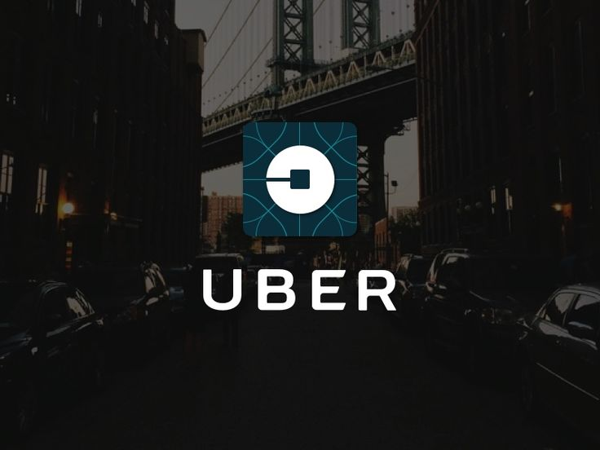
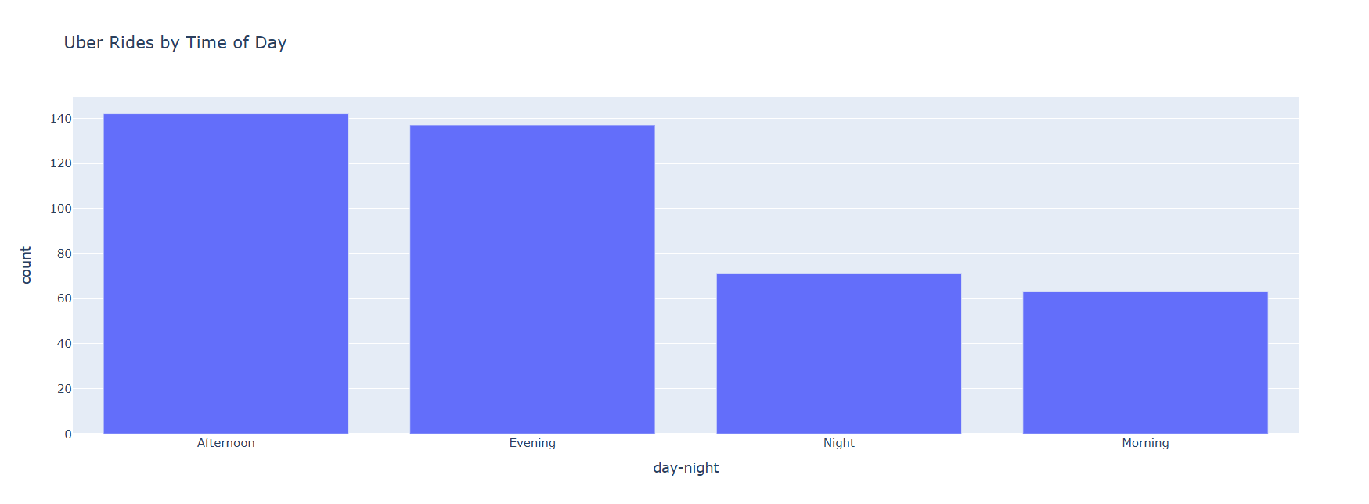
3.At what time do people book cabs the most from uber?
Observation:-To find the peak booking times for Uber, analyzing ride data by hour would reveal trends. Typically, people book cabs the most during rush hours (7-9 AM and 5-7 PM) for commuting, followed by late-night bookings around weekends due to social events and nightlife.
Key Observation:-

Slide 8
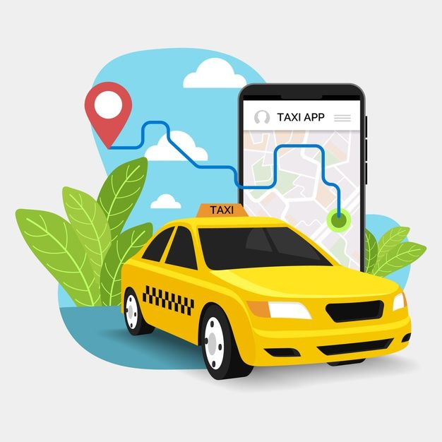
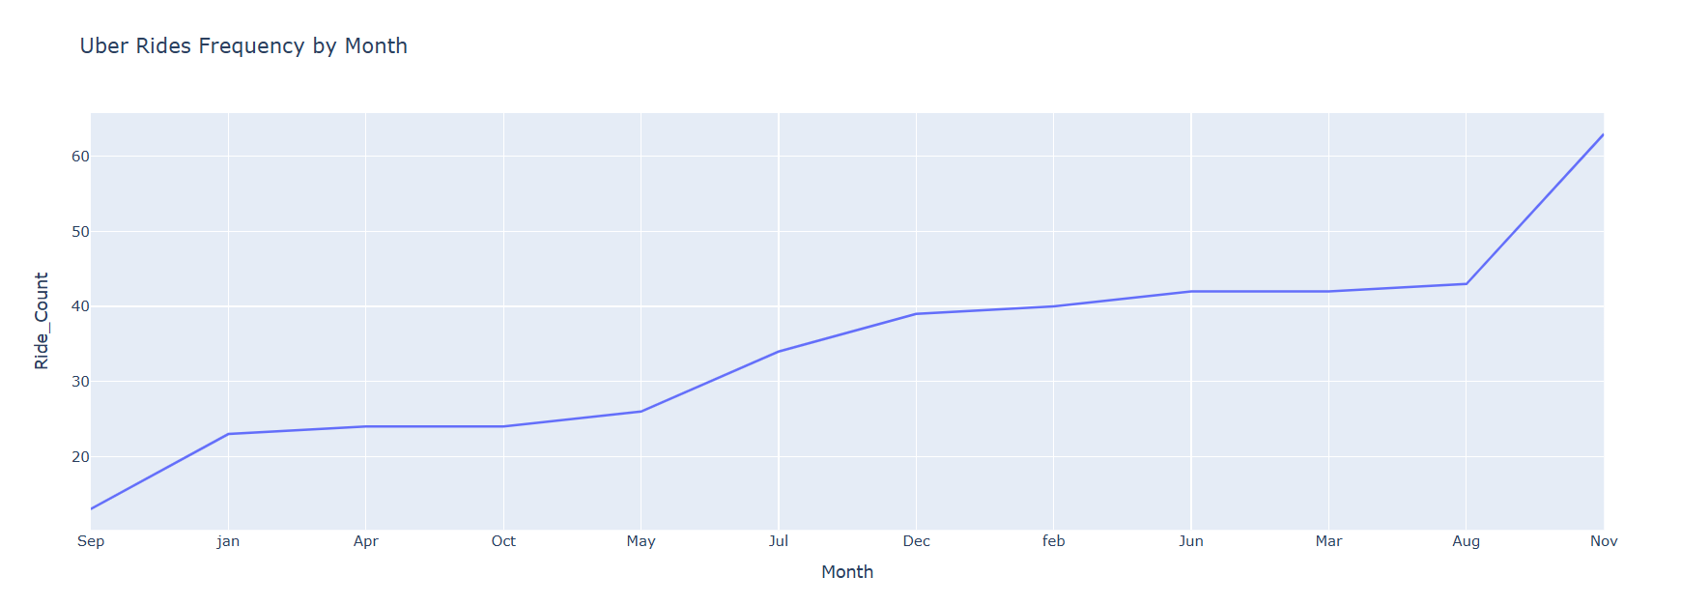
4.In which months do people book uber rides less frequently?
Observation:-Uber rides are generally booked less frequently during winter months like January and February, especially in regions with cold weather, as people tend to travel less due to unfavorable conditions. Additionally, post-holiday months such as January often see a drop in ride requests after the busy holiday season in December. In some regions, September may also experience a dip as it falls between the summer vacation period and the upcoming holiday season. However, ride frequency can vary by location, with regional events and climate playing significant roles in determining demand fluctuations throughout the year.

Slide 9
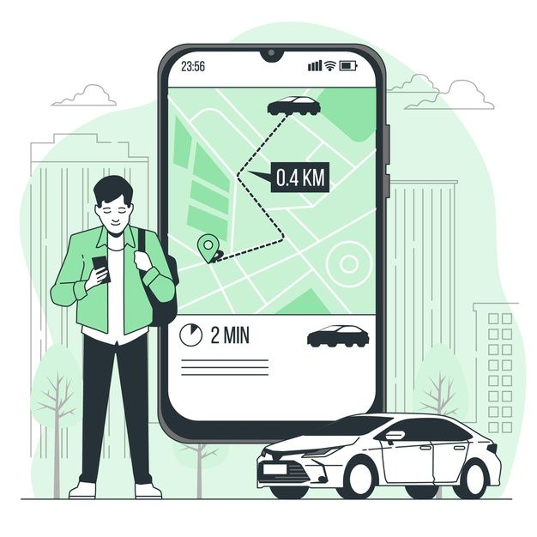
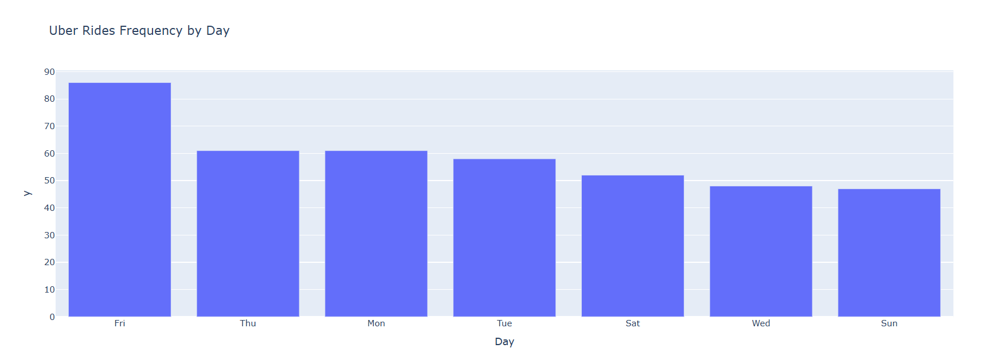
5.On which days of the week do people book uber rides the most?
Observation:-People tend to book Uber rides the most on Fridays and Saturdays. These days typically see higher demand due to social activities, dining out, nightlife, and events. Many people use Uber for transportation to and from restaurants, bars, and entertainment venues. Friday afternoons and evenings mark the start of the weekend, driving up demand. Saturdays continue with high booking rates, especially during evening hours. Additionally, Sundays see increased bookings, particularly in the afternoon and evening, as people return from weekend activities or travel. These trends highlight the link between leisure time and higher Uber ride demand.

Slide 10
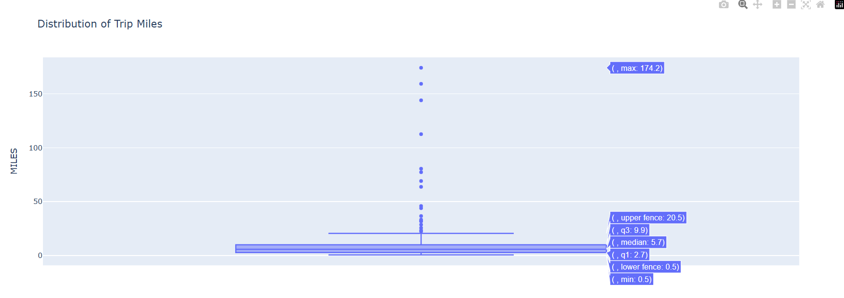
6.How many miles do people usually book a cab for through uber?
Observation:-The average distance for an Uber ride varies depending on the type of trip and location, but generally, rides are around 3 to 5 miles in urban areas. Short trips within a city, like commuting or running errands, tend to be on the lower end of this range. For longer trips, such as airport rides or trips between neighborhoods, distances can exceed 10 miles. Rural areas may have longer average ride distances due to more spread-out destinations. In cities, most Uber rides fall within the 3 to 6-mile range, reflecting short to medium-distance urban travel.

Slide 11
Conclusion:-
In conclusion, the Uber platform has revolutionized urban transportation by offering an affordable, convenient, and efficient alternative to traditional taxi services. By utilizing technology, Uber has created a seamless user experience that caters to a diverse range of customers, from daily commuters to occasional riders seeking convenience. The flexibility of the service, including various ride options (UberX, Uber XL, Uber Pool, etc.), allows users to select rides based on their needs and budgets, further enhancing its appeal.
Additionally, Uber has contributed to reducing the overall cost of transportation, providing a reliable option for both short and long-distance travel. Through its surge pricing model, Uber adapts to demand fluctuations, ensuring driver availability during peak times. While the service offers numerous benefits, it also faces challenges such as regulatory scrutiny, competition, and concerns about the impact on local taxi industries.
Uber's expansion into different markets and the integration of new technologies, like self-driving cars, indicates its potential to continue reshaping the transportation landscape. However, for sustained success, Uber will need to address the challenges it faces, including maintaining driver satisfaction, managing public perception, and navigating local government regulations. The future of Uber remains promising, with opportunities for growth in urban mobility and beyond.

Slide 12
Thank you

